Slide 1
Research and Development
S. Nazim Ali
Harvard Law School

Slide 2
Academic Research
Academic Research (including theoretical studies): universities, colleges, and research institutes
which regions are producing what

Slide 3
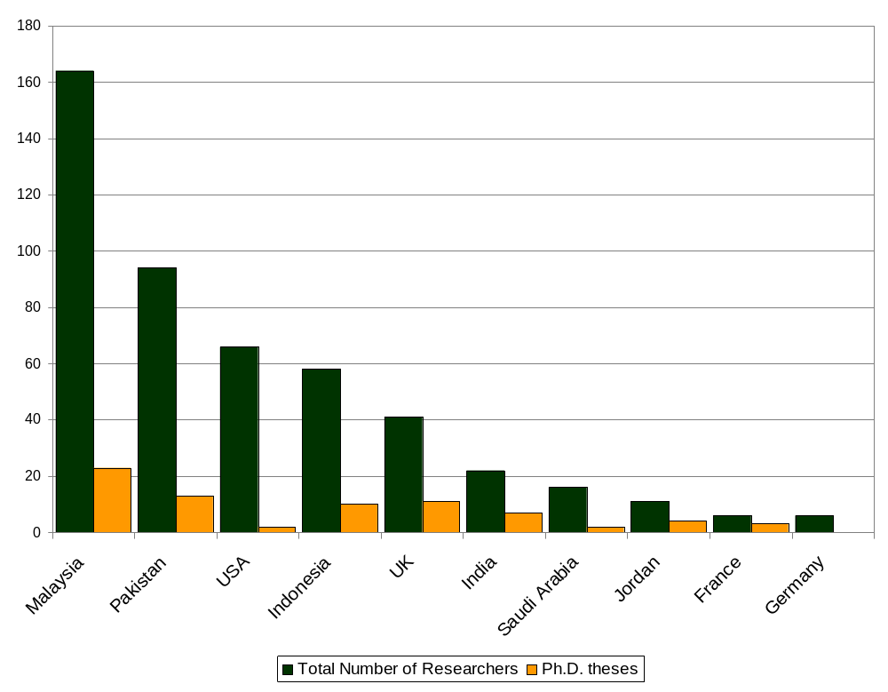
Research Projects and PhD theses

Slide 4
Applied Research
Applied Research: in-house corporate research, less publicly available material then academic research because most is not published

Slide 5
Applied Research
  IRTI, Islamic Development Bank
  Kuwait Finance House; Dubai Islamic Bank’s journal Iqtisaduna
  Bank Islam Malaysia Institute of Research & Training
  Accounting & Auditing Organization for Islamic Financial Institutions (AAOIFI)
  General Council of Islamic Banking and Financial Institutions (GCIBFI)
  Islamic Financial Services Board (IFSB)

Slide 6
RESEARCH vs. PRACTICE
1. research lays the theoretical groundwork for Islamic finance and economics
2. theoretical knowledge
converted to practice:
dissemination of research expertise
Research
Industry
4. industry spurs
more research,
education, training
3. creates demand for product innovation
and intellectual capital
Notes:
We go back to the previous diagram.
In the 40s to 60s, the theoretical basis for IFE began to emerge
In the 70s, this knowledge became practical reality as the industry emerged. After some time, in the 90s, this growth created more demand for sophisticated products and services etc.
That led to the development of standards as well as spurred new efforts in research, education and training. As this new research matures, the industry again takes it upon itself to apply this new findings and bring it out to market, starting the entire cycle again.
The rapid rise of Islamic banking and financing over the last four decades has been accompanied by a substantial increase in the research activities being conducted in the field. A considerable amount of written work has been (and is being) produced on the subject, and has already had a great impact on the growth of Islamic finance both within the Islamic nations and beyond. The significance of such research activity cannot be understated, as Islamic banking is still very much in its growth stage. As is, it faces stiff competition from traditional interest-based banks, which already have the experience, the financial resources, and the infrastructure in place. Research and development activities must therefore form the backbone of the Islamic finance revolution, geared towards gaining a better understanding of the markets in general as well as adapting traditional Islamic finance instruments to the needs of modern times.

Slide 7
Industry Growth - Industry Research, Education, and Training
Industry building efforts
Previous experience – International Association of Islamic Banks
General Council of Islamic Banking and Financial Institutions
AAOIFI
International Islamic Rating Agency (International benchmarks)
IFSB Islamic Financial Services Board (est. by IMF, BMI, BNM, and IDB)

Slide 8
Co-operation and Coordination –
Some Challenges
  Lack of coordination, most of research is not results-oriented and thus has little impact on the field
  Relative scarcity of research conducted in other languages beside English
  Duplication of research

Slide 9
Funding Research
  IRTI Scholarship for PhDs
  AAOIFI and IFSB support to industry players and central banks for research on industry-wide problems
  INCEIF

Slide 10
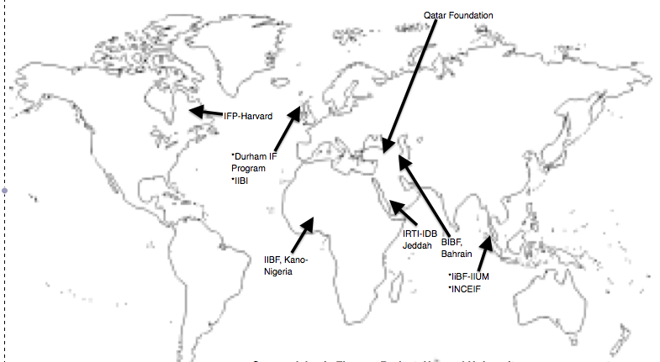
Degree and Training Programs

Slide 11
Research Development – Some Journals
Islamic Economic Studies (Saudi Arabia)
Review of Islamic Economics (United Kingdom)
Contemporary Jurisprudence Research Jrl (Arabic)
IIUM J of Economics and Management (Malaysia)
Intl Journal of Islamic Financial Services (India)
King Abdul Aziz Uni - Islamic Economics (Saudi Arabia)
Jrl of Muamalat & Islamic Finance Research (Malaysia)
Journal of Islamic Banking & Finance (Pakistan)
Islamic Banking and Finance (United Kingdom)

